Slide 1

WCF Services
Build up WCF services for AngularJS requests
Radu Lacatus, Agile developer
May 17, 2016

Slide 2
WCF
Windows Communication Foundation: an extensible and configurable SDK to develop and deploy services on Windows.

Slide 3
WCF basics
A,B,C
Extensibility points
Demo – configure WCF services for AngularJS requests

Slide 4
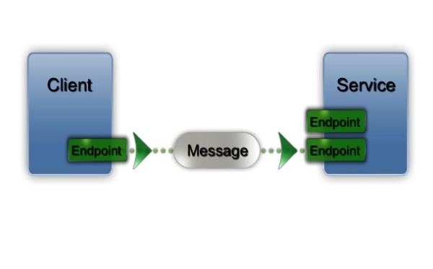
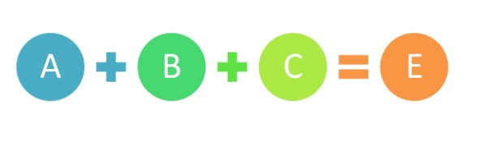
Endpoints

Slide 5
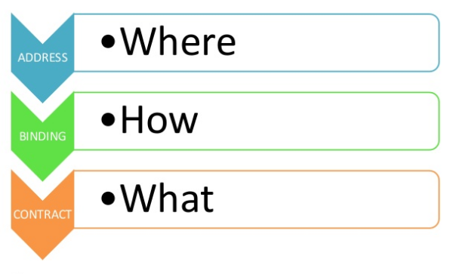
The ABC of WCF

Slide 6
Address
It’s an URL that identifies the location of the service
Scheme + Machine + Port + Path

Slide 7
Binding
Describes how a service communicates:
Protocol
Encoding method
Security requirements
Communication pattern
Binding classes:
Binding name | Transport | Encoding | Interoperable
BasicHttpBinding | HTTP/HTTPS | Text,MTOM | Yes
NetTcpBinding | TCP | Binary | No
WsFederatuibHttpBinding | HTTP/HTTPS | Text,MTOM | Yes
NetMsmqBinding | MSMQ | Binary | No
ETC!!!
You can also create and plug in custom bindings

Slide 8
Contract
A platform neutral and standard way to say what the service does
Types of contract:
Service contract – describes the operations that the service can perform
Data contract – describes the data types used by the service (parameters and return values)
Fault contract – which errors can be raised by the service
Message contract – also refers to the data types but gives you more control on how the actual message looks (header and body customisations)

Slide 9
Extensibility points
1. IDispatchMessageInspector.AfterRecieveRequest
2. IDispatchOperationSelector.SelectOperation
3. IDispatchMessageFormatter.DeserializeRequest
4. IParameterInspector.BeforeCall
5. IOperationInvoker.Invoke
Message Inspection
Operation Selector
Message Formatting
Parameter Inspection
Operation Invoker
8. IDispatchMessageInspector.BeforeSendReply
7. IDispatchMessageFormatter.SerializeReply
6. IParameterInspector.AfterCall

Slide 10
DEMO

Slide 11
Resources
MSDN: https://msdn.microsoft.com/en-us/library/ms735119(v=vs.90).aspx
More detailed presentation: http://www.slideshare.net/PeterREgli/windows-communication-foundation-wcf-11426496
Demo project: https://github.com/radulacatus/Bundesliga

